Slide 1
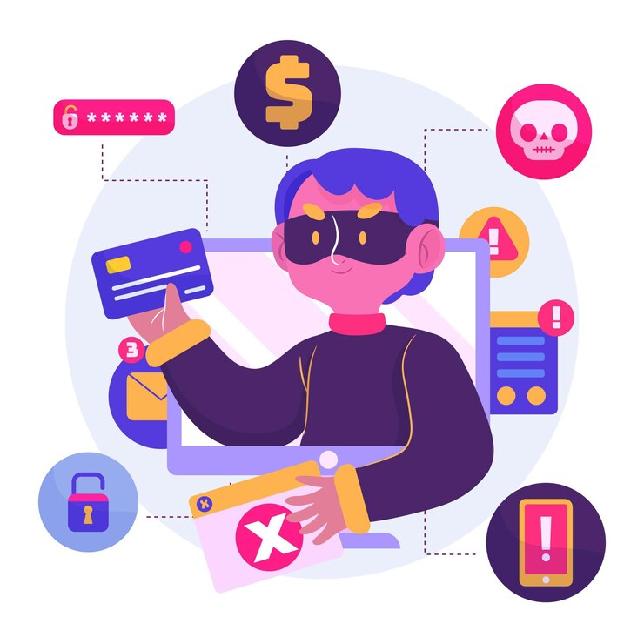
Combating Piracy in eCommerce
Name : Sourav Saha
ID : 0112330638
Course Title : Society, Environment and Computing Ethics
Group Topic : Piracy
Section : D

Slide 2

Challenges of Piracy
Economic Losses from Piracy
$51 billion lost annually due to piracy in software industry.
Music, movies and eBooks industries also face significant revenue decline.
Indirect effects: Decrease in innovation, reduced investor confidence.
Fewer opportunities for developers and artists.

Slide 3
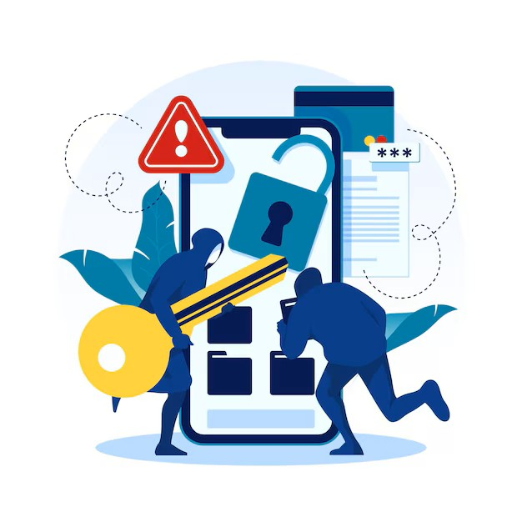
Challenges of Piracy
Security Risks of Piracy
Malware, spyware and ransomware hidden in pirated products.
Data theft: Credit card details, passwords, and sensitive files stolen.
Companies, unknowingly using pirated software face data breaches.
Increased operational costs for damage control and recovery.

Slide 4
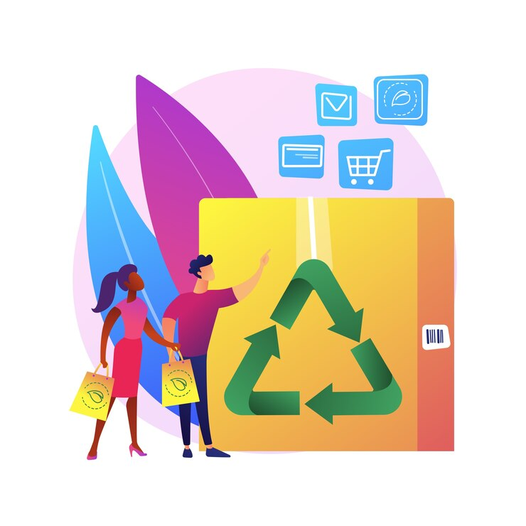
Challenges of Piracy
Consumer Trust and Brand Impact
Consumer lose faith in platforms hosting counterfeit goods.
Companies selling pirated or counterfeit products suffer reputational damage.
Consumers may face consequences for unknowingly buying pirated products.

Slide 5
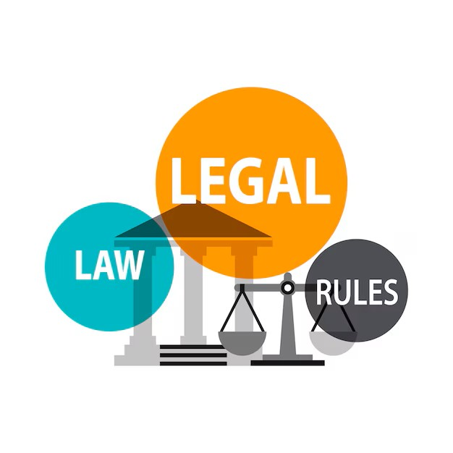
Legal Measures Against Piracy
Legal Frameworks to Combat Piracy
WIPO Copyright Treaty (1996): Digital rights protection.
Berne Convention (1886): Copyright standardization across borders.
TRIPS Agreement (1994): Stronger global enforcement of intellectual property rights.
USA: DMCA, SOPA
Europe: Copyright Directives under GRPR.
Bangladesh: Emerging copyright laws under the Digital Security Act.

Slide 6

Solutions to Piracy
Technology-Based Solutions:
AI-based tools for piracy detection.
Blockchain for verifying digital product authenticity.
Educational Campaigns:
Raising awareness about the consequences of piracy.
Promoting ethical use of digital goods.
International Cooperation:
Cross-border legal collaboration to combat piracy networks.

Slide 7

Key Takeaways
Impact of Piracy:
Annual losses of billions of dollars in revenue.
It reduces trust in online shopping.
Affects businesses and slows innovation.
Challenges:
Hard to balance copyright laws with user privacy.
Developing countries face issues with resources to stop piracy.
Opportunities:
Tools like AI and blockchain can stop piracy.
Countries need to work together for better results.

Slide 8
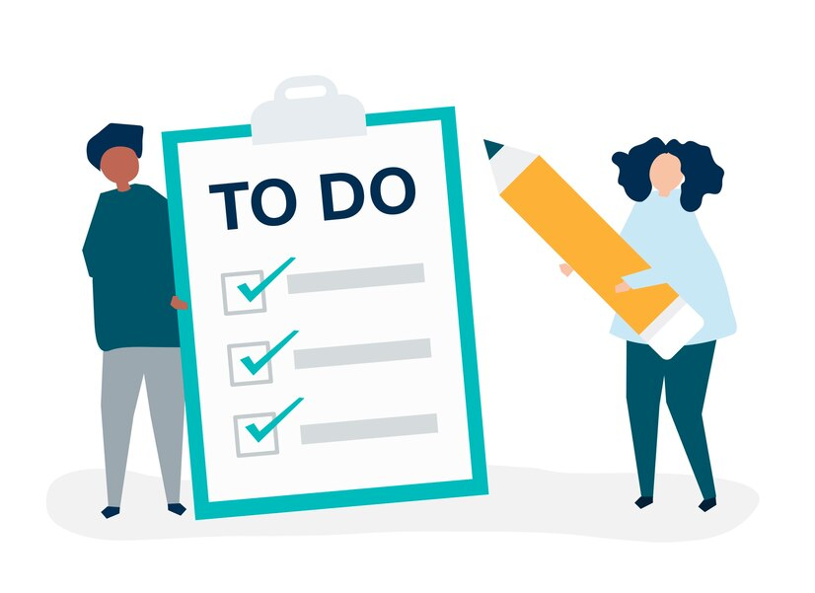
What We Can Do
Consumers:
Always buy from trusted platforms.
Report fake or pirated products on eCommerce sites.
Governments:
Make stronger copyright laws.
Support global efforts to stop piracy.
Businesses:
Use secure tools to protect products.
Offer fair pricing to reduce piracy.

Slide 9


